Slide 1

R Programming Concepts
Sep 13-14, 2023
You should have R & RStudio installed
https://sites.northwestern.edu/researchcomputing/resources/r-and-rstudio/
Download materials from:
https://github.com/nuitrcs/R-programming-concepts-Chicago-2023

Slide 2
Research Computing and Data Services
Ritika Giri
Christina Maimone
efrén cruz cortés
We're here to help after the workshops!
bit.ly/rcdsconsult

Slide 3
BYOD
BYOD = Bring Your Own Data
Small working groups, meet weekly for 8 weeks
https://sites.northwestern.edu/researchcomputing/events-and-programs/byod/

Slide 4
What are we doing today?
Getting to know R and RStudio
Learning concepts that you need for R (that also apply to other programming languages)

Slide 5
What are we doing?
Topics
R / Rstudio
File paths
Working directory
R scripts and Documents
Functions
Variables
Packages
Importing data
Data frames
Indexing data frames and vectors
Subsetting data
Missing values

Slide 6

Who are you?
Done any coding before?
Majored in?
Love cats?
Feeling apprehensive?
Feeling confident?
Used R before?

Slide 7

Terminology
Programming Languages, Consoles, and GUIs

Slide 8
GUIs
GUI: Graphical User Interface: Programs on your computer with buttons and other visual elements; you can interact with a mouse or touchscreen
Powerpoint, Word, SPSS, Zoom, internet browser, etc.

Slide 9

Problem: How do we tell others what we did? How do we keep track of what we did for ourselves?

Slide 10
Programming Languages
A system for giving instructions to a computer (writing code)
Specific words and characters in a specific order

Slide 11
Console/Terminal/Shell/Command Line Interface
Simple computer program where we type commands, one line at a time (hence: command line)
They can run different “languages”: bash, zsh, PowerShell (Windows), R, Python
Type instructions at a prompt (> or $ or % or >>> or : or others)
Used for basic operations and running other programs

Slide 12
Console/Terminal/Shell
MacOS:
Applications > Terminal
In RStudio, "Terminal" tab (we'll see this later)
Language-specific consoles (like R)
Windows:
Windows Console or Command Prompt (Start button, search for cmd)
PowerShell
Language-specific consoles (like R)

Slide 13

Let’s open the Terminal…

Slide 14
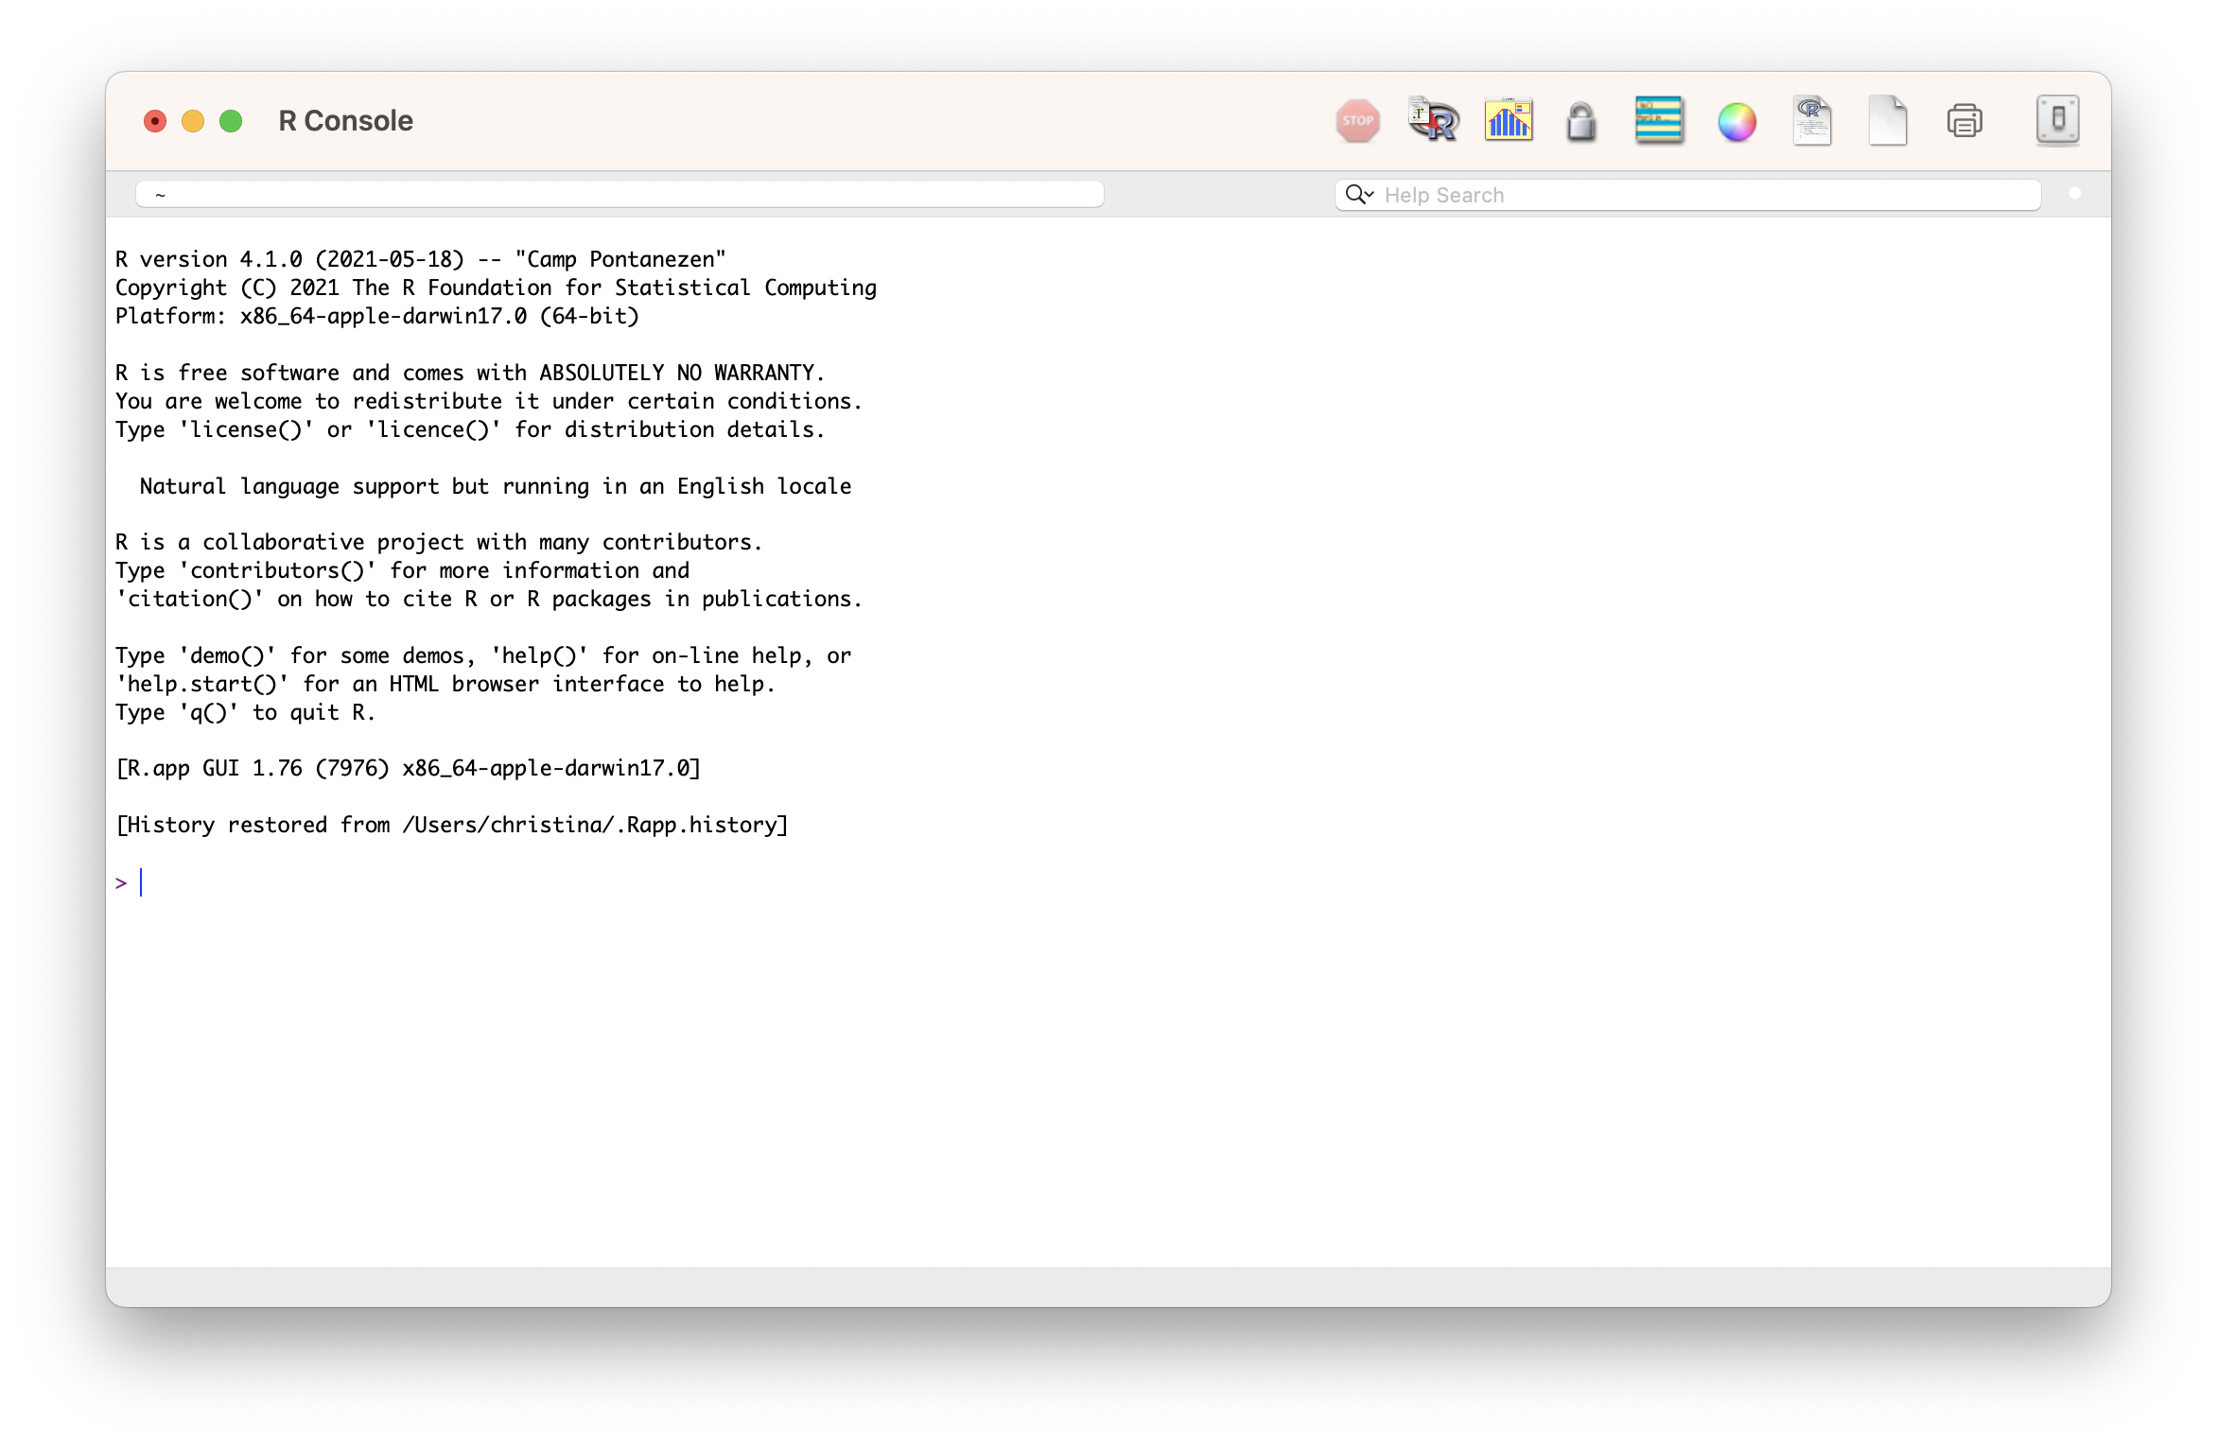

Slide 15

But that’s sometimes annoying and inconvenient… and how do we record what we did?

Slide 16
IDEs
IDE: Integrated Development Environment (e.g. RStudio): A GUI that helps make writing computer programs easier and interfaces with an interpreter or compiler
Usually includes:
File explorer
Area for writing code/scripts
Console for running interpreted languages
General terminal window for your system

Slide 17


Slide 18
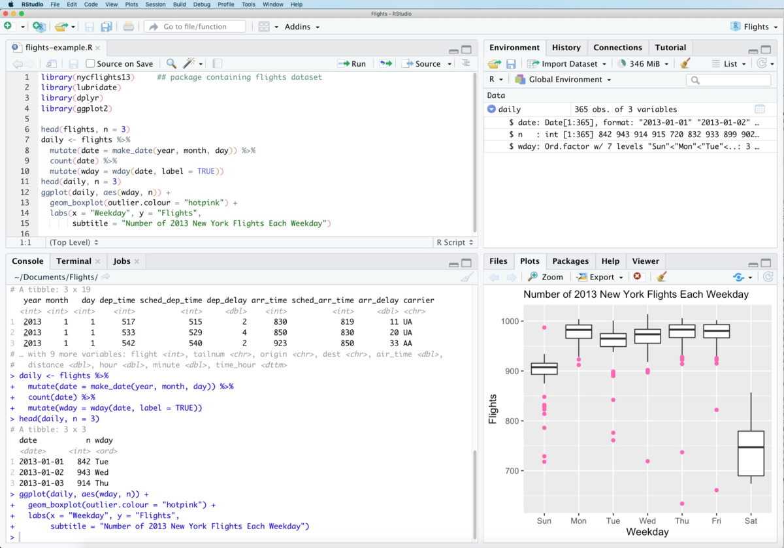
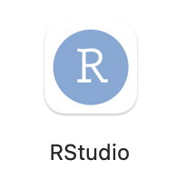

Slide 19
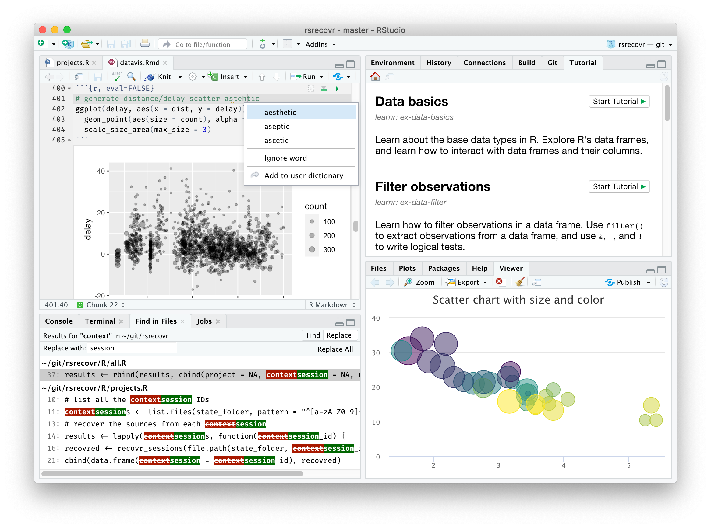
Let’s open RSTUDIO

Slide 20

Everything that is an R command still has to run through the R interpreter (in the R console in RStudio)
Some buttons and menus write R code for us…

Slide 21

YAY!
We can keep a full record of everything we do!
Don’t have to write down instructions like:
open this menu, pick this option, check the third button, etc.
where the steps might vary with software version, operating system, etc

Slide 22


YAY!
We can keep a full record of everything we do!
Don’t have to write down instructions like:
open this menu, pick this option, check the third button, etc.
where the steps might vary with software version, operating system, etc
Means we can do reproducible science and research
Does not mean that this happens automatically!

Slide 23
Which of these are true?
A: RStudio is a programming language
B: R and RStudio are the same program
C: RStudio is an IDE
D: RStudio is a GUI
E: R automatically makes our code reproducible
F: All R commands have to run through the R console

Slide 24
Open RStudio
Type some math equations in the console and get answers
> Press enter at the end of a line to run the command
Open the file script1.R in RStudio
File menu > Open File…
or
Navigate to the file in the bottom right Files window in RStudio and click on the file to open it

Slide 25
Data Types & Boolean Operators
Head back to RStudio...script2.R

Slide 26
Which of these are true?
A: "\n" is an empty string
B: (TRUE & FALSE) | (FALSE | TRUE)
C: TRUE == 1
D: “Dog” == “dog”
E: "this is a valid character data'
F: The value false can be represented as: FALSE, F, or false

Slide 27
Variables

Slide 28

Variables
3

Slide 29
Variables
“dog”

Slide 30
Variables
TRUE

Slide 31
Variables
x

Slide 32
Variables
x
TRUE

Slide 33
Variables
x = 3
x <- 3
Variable name
"Left hand side"
Assignment
operator
Value
"Right hand side"

Slide 34
Variables
x <- 3
<- is preferred in R

Slide 35
Variables
x <- 3 + 5
x
x is 8

Slide 36
Variables
x <- 3
x + 5
x
x is 3

Slide 37
Variables
x <- 3
x <- x + 5
x
x is 8

Slide 38
Variables
x <- 3
y <- 5
x <- x + y
x
x is 8

Slide 39
Variables
x <- 3
y <- 5
x <- x + y
y <- 7
x
x is 8

Slide 40
Vectors and Lists

Slide 41
Storing Multiple Values Together
We combine them with c() into a vector
x <- c(2, 4, 7, 8)
Vectors may be called arrays or lists in other languages

Slide 42
Variables
c(2, 4, 7, 8)
x

Slide 43
Index the Values in a Vector
1 2 3 4
Indices in R start with 1
x <- c(2, 4, 7, 8)

Slide 44
Index the Values in a Vector
Indices in R start with 1
x <- c(2, 4, 7, 8)
x[1] is 2
x[2] is 4
Index goes inside
[]
x is the name of the variable with a vector

Slide 45
Changing values in a vector
x <- c(2, 4, 7, 8)
x[2] <- 6
x
2, 6, 7, 8

Slide 46
Changing a variable
x <- c(2, 4, 7, 8)
x <- 6
x
6
R doesn’t care what’s in the variable “bag”!

Slide 47

Back to RStudio…
Open script3.R

Slide 48
Functions

Slide 49
Functions
Units of code
Take input values (arguments)
Can return an output value (e.g. a return value)
R functions usually don't alter their input values (but they sometimes do!)

Slide 50
Function Definitions
read.csv(file, header = TRUE, sep = ",", quote = "\"",
dec = ".", fill = TRUE, comment.char = "", ...)

Slide 51
Function Definitions: Function Name
read.csv(file, header = TRUE, sep = ",", quote = "\"",
dec = ".", fill = TRUE, comment.char = "", ...)

Slide 52
Function Definitions: Parameters
read.csv(file, header = TRUE, sep = ",", quote = "\"",
dec = ".", fill = TRUE, comment.char = "", ...)

Slide 53
Function Definitions: Parameter Names
read.csv(file, header = TRUE, sep = ",", quote = "\"",
dec = ".", fill = TRUE, comment.char = "", ...)
Notes:
Variables that exist inside the function -- can have the same name as your variables -- it's OK

Slide 54
Function Definitions: Default Values
read.csv(file, header = TRUE, sep = ",", quote = "\"",
dec = ".", fill = TRUE, comment.char = "", ...)

Slide 55
Function Definitions: Required Parameters
read.csv(file, header = TRUE, sep = ",", quote = "\"",
dec = ".", fill = TRUE, comment.char = "", ...)

Slide 56
Function Definitions: Additional Undefined Parameters
read.csv(file, header = TRUE, sep = ",", quote = "\"",
dec = ".", fill = TRUE, comment.char = "", ...)

Slide 57
Calling Functions: R: Named Arguments
read.csv(file, header = TRUE, sep = ",", quote = "\"",
dec = ".", fill = TRUE, comment.char = "", ...)
read.csv(file=“results.txt”,
header=TRUE,
sep=“\t”)
Notes:
In R, we call named arguments, keyword arguments.

Slide 58

Calling Functions: R: Named Arguments
read.csv(file, header = TRUE, sep = ",", quote = "\"",
dec = ".", fill = TRUE, comment.char = "", ...)
read.csv(sep=“\t”,
file=“results.txt”,
header=TRUE)
Notes:
In R, we call named arguments, keyword arguments.

Slide 59
Calling Functions: R: Positional Arguments
read.csv(file, header = TRUE, sep = ",", quote = "\"",
dec = ".", fill = TRUE, comment.char = "", ...)
read.csv(“results.txt”, TRUE, “\t”)
Notes:
In R, we call named arguments, keyword arguments.

Slide 60
Calling Functions: R: Positional Arguments
read.csv(file, header = TRUE, sep = ",", quote = "\"",
dec = ".", fill = TRUE, comment.char = "", ...)
1, 2, 3
read.csv(“results.txt”, TRUE, “\t”)
Notes:
In R, we call named arguments, keyword arguments.

Slide 61
Calling Functions: R: Positional and Named
read.csv(file, header = TRUE, sep = ",", quote = "\"",
dec = ".", fill = TRUE, comment.char = "", ...)
read.csv(file=“results.txt”, TRUE, “\t”)
Notes:
In R, we call named arguments, keyword arguments.

Slide 62
Calling Functions: R: Positional and Named
read.csv(file, header = TRUE, sep = ",", quote = "\"",
dec = ".", fill = TRUE, comment.char = "", ...)
read.csv(file=“results.txt”, TRUE, “\t”)
Match named arguments first,
Notes:
In R, we call named arguments, keyword arguments.

Slide 63
Calling Functions: R: Positional and Named
read.csv(file, header = TRUE, sep = ",", quote = "\"",
dec = ".", fill = TRUE, comment.char = "", ...)
read.csv(file=“results.txt”, TRUE, “\t”)
Match named arguments first,
Match positions in order – 1
Notes:
In R, we call named arguments, keyword arguments.

Slide 64
Calling Functions: R: Positional and Named
read.csv(file, header = TRUE, sep = ",", quote = "\"",
dec = ".", fill = TRUE, comment.char = "", ...)
read.csv(file=“results.txt”, TRUE, “\t”)
Match named arguments first,
Match positions in order – 1
Match positions in order – 2
Notes:
In R, we call named arguments, keyword arguments.

Slide 65
Calling Functions: R: Positional and Named
read.csv(file, header = TRUE, sep = ",", quote = "\"",
dec = ".", fill = TRUE, comment.char = "", ...)
read.csv(header=TRUE, “results.txt”, “\t”)
Notes:
In R, we call named arguments, keyword arguments.

Slide 66
Calling Functions: R: Positional and Named
read.csv(file, header = TRUE, sep = ",", quote = "\"",
dec = ".", fill = TRUE, comment.char = "", ...)
read.csv(header=TRUE, “results.txt”, “\t”)
Match named argument first,
Notes:
In R, we call named arguments, keyword arguments.

Slide 67
Calling Functions: R: Positional and Named
read.csv(file, header = TRUE, sep = ",", quote = "\"",
dec = ".", fill = TRUE, comment.char = "", ...)
read.csv(header=TRUE, “results.txt”, “\t”)
Match named argument first,
Match positions in order – 1
Notes:
In R, we call named arguments, keyword arguments.

Slide 68
Calling Functions: R: Positional and Named
read.csv(file, header = TRUE, sep = ",", quote = "\"",
dec = ".", fill = TRUE, comment.char = "", ...)
read.csv(header=TRUE, “results.txt”, “\t”)
Match named argument first,
Match positions in order – 1
Match positions in order – 2
Notes:
In R, we call named arguments, keyword arguments.

Slide 69
Calling Functions: R
read.csv(file, header = TRUE, sep = ",", quote = "\"",
dec = ".", fill = TRUE, comment.char = "", ...)
Notes:
In R, we call named arguments, keyword arguments.

Slide 70
Calling Functions: R: Will it work?
read.csv(file, header = TRUE, sep = ",", quote = "\"",
dec = ".", fill = TRUE, comment.char = "", ...)
read.csv("results.txt", sep="\t")
read.csv("results.txt", "\t")
read.csv("results.txt", TRUE, "\t")
Notes:
In R, we call named arguments, keyword arguments.

Slide 71
Calling Functions: R: Will it work?
read.csv(file, header = TRUE, sep = ",", quote = "\"",
dec = ".", fill = TRUE, comment.char = "", ...)
read.csv("results.txt", sep="\t")
Notes:
In R, we call named arguments, keyword arguments.

Slide 72
Calling Functions: R: Will it work?
read.csv(file, header = TRUE, sep = ",", quote = "\"",
dec = ".", fill = TRUE, comment.char = "", ...)
read.csv("results.txt", sep="\t")
read.csv("results.txt", "\t")
Notes:
In R, we call named arguments, keyword arguments.

Slide 73
Calling Functions: R
read.csv(file, header = TRUE, sep = ",", quote = "\"",
dec = ".", fill = TRUE, comment.char = "", ...)
read.csv("results.txt", sep="\t")
read.csv("results.txt", "\t")
Notes:
In R, we call named arguments, keyword arguments.

Slide 74
Calling Functions: R
read.csv(file, header = TRUE, sep = ",", quote = "\"",
dec = ".", fill = TRUE, comment.char = "", ...)
read.csv("results.txt", sep="\t")
read.csv("results.txt", "\t")
read.csv("results.txt", TRUE, "\t")
Notes:
In R, we call named arguments, keyword arguments.

Slide 75
Calling Functions: Return Values
abs(-3)
Returns: 3
If we want to save the output:
x <- abs(-3)

Slide 76
Calling Functions: No Return Value
print("Hello World!")
>> Called for their side-effects (what they do)
x = print("Hello World!")

Slide 77
Calling Functions: Variable Arguments
x <- "Hello World!"
print(x)
file <- "results.csv"
read.csv(file = file)

Slide 78

Back to RStudio…
Open script4.R

Slide 79
File Systems
Where does R think it is?

Slide 80
File Paths
How do we tell R where our files are without using point and click interfaces?
Every file has an absolute path, which starts with the root

Slide 81
PC (Windows)
c:

Slide 82

C:\
PC (Windows)
c:
Program Files
Users
System

Slide 83
C:\Users\
PC (Windows)
c:
Program Files
Users
System
ritika
guest

Slide 84
C:\Users\ritika\
PC (Windows)
c:
Program Files
Users
System
ritika
guest
Documents
Desktop
Music
Photos

Slide 85
C:\Users\ritika\Documents\
PC (Windows)
c:
Program Files
Users
System
ritika
guest
Documents
Desktop
Music
Photos
dissertation
my_project

Slide 86

C:\Users\ritika\Documents\my_project
PC (Windows)
c:
Program Files
Users
System
ritika
guest
Documents
Desktop
Music
Photos
dissertation
my_project
data.csv
process.py
DRAFT.docx

Slide 87
C:\Users\ritika\Documents\my_project\data.csv
PC (Windows)
c:
Program Files
Users
System
ritika
guest
Documents
Desktop
Music
Photos
dissertation
my_project
data.csv
process.py
DRAFT.docx

Slide 88
/Users/ritika/Documents/my_project/data.csv
MacOS
/
Applications
Users
System
ritika
guest
Documents
Desktop
Music
Photos
dissertation
my_project
data.csv
process.py
DRAFT.docx

Slide 89
Absolute Paths
C:\Users\ritika\Documents\my_project\data.csv
/Users/ritika/Documents/my_project/data.csv

Slide 90
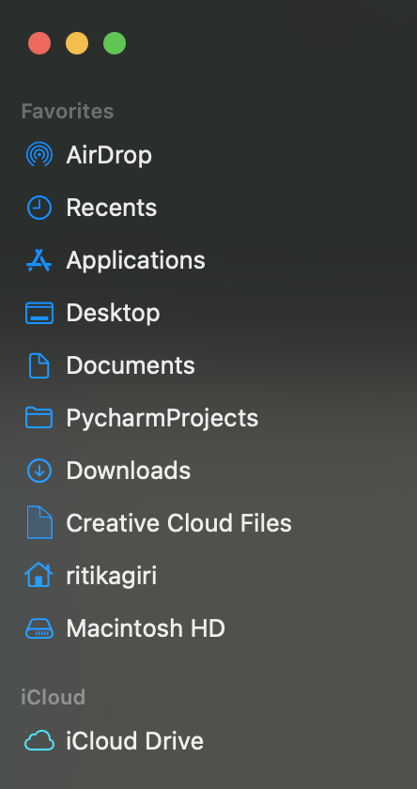
Home Directory

Slide 91
Home Directory: C:\Users\ritika = ~
c:
Program Files
~
Users
System
ritika
guest
Documents
Desktop
Music
Photos
dissertation
my_project
data.csv
process.py
DRAFT.docx

Slide 92
~/Documents/my_project/data.csv
c:
Program Files
Users
System
ritika
guest
Documents
Desktop
Music
Photos
dissertation
my_project
data.csv
process.py
DRAFT.docx

Slide 93
Working Directory
A directory in the filesystem associated with a running process or program
>> Where the computer starts when looking for files
>> Relative File Paths

Slide 94
Relative Path from Documents: my_project/data.csv
c:
Program Files
Users
System
ritika
guest
Documents
Desktop
Music
Photos
dissertation
my_project
data.csv
process.py
DRAFT.docx

Slide 95
From ritika:
c:
Program Files
Users
System
ritika
guest
Documents
Desktop
Music
Photos
dissertation
my_project
data.csv
process.py
DRAFT.docx
Notes:
Documents/my_project/data.csv

Slide 96
From ritika: Documents/my_project/data.csv
c:
Program Files
Users
System
ritika
guest
Documents
Desktop
Music
Photos
dissertation
my_project
data.csv
process.py
DRAFT.docx
Notes:
Documents/my_project/data.csv

Slide 97
.. means go up a level

Slide 98
From Desktop: ../Documents/my_project/data.csv
c:
Program Files
Users
System
ritika
guest
Documents
Desktop
Music
Photos
dissertation
my_project
data.csv
process.py
DRAFT.docx
Notes:
Documents/my_project/data.csv

Slide 99
From dissertation: ../Documents/my_project/data.csv
c:
Program Files
Users
System
ritika
guest
Documents
Desktop
Music
Photos
dissertation
my_project
data.csv
process.py
DRAFT.docx
Notes:
Documents/my_project/data.csv

Slide 100
From dissertation: ../my_project/data.csv
c:
Program Files
Users
System
ritika
guest
Documents
Desktop
Music
Photos
dissertation
my_project
data.csv
process.py
DRAFT.docx
Notes:
Documents/my_project/data.csv

Slide 101
But what is the Working Directory for R?
Default: home directory
RStudio Projects: the folder you associate with the project
>> You can set or change the working directory
Let’s go to R for a minute…

Slide 102
Why not just use absolute paths?

Slide 103
Store Project Files Together
project_directory
code
process_data.r
make_graphs.r
estimate_model.r
data
people.csv
exam1.csv
output
impact_plot.pdf
reports
chapter1.docx
working directory

Slide 104

Back to RStudio…
Open script5.R

Slide 105
Working with Files
Reading and writing

Slide 106
Plain Text Files
NO FORMATTING
NO IMAGES
Common extensions: .txt, .tab, .csv
Also plain text:
Data files: XML, JSON
Markup: HTML, Markdown (.md), LaTeX (.tex)
Code: R scripts (.r), Python scripts (.py)
Notes:
But it's not about the extension -- extension doesn't determine if a file is plain text

Slide 107
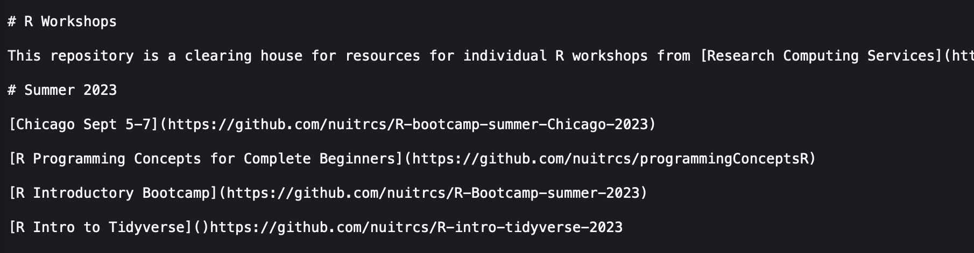
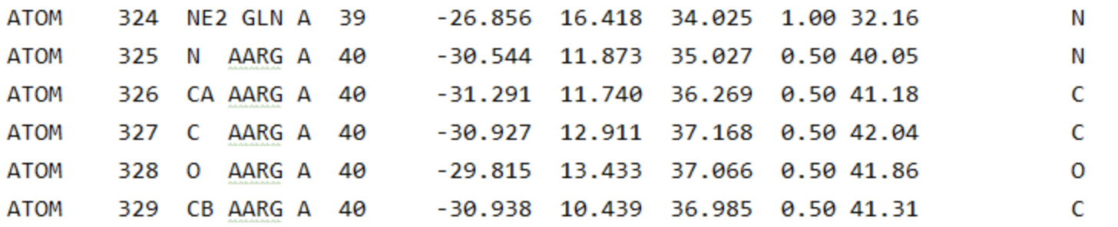
Plain Text Files
https://raw.githubusercontent.com/nuitrcs/rworkshops/master/README.md
File: molecule.pdb

Slide 108
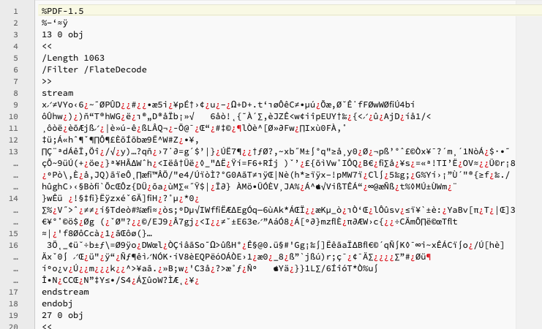
Not a Plain Text File

Slide 109
Plain Text Editors
RStudio lets you write (or open) plain text files (so do other IDEs)
Stand alone options:
Mac: BBEdit
Windows: Notepad ++
Either: Sublime Text
Usually avoid built-in options: Notepad, TextEdit, WordPad

Slide 110

R Markdown/QuaRTo
Back to RStudio...

Slide 111
Data FRAMEs
Rectangles of Data

Slide 112

Rectangles of Data
View(data)

Slide 113
Rows: Observations
nrow(data)
Person (or mouse, worm, etc.)
Country
Year
Run/trial of an experiment
Chemical
Sample

Slide 114
Columns: Variables
ncol(data)
Measurements
Grouping/identification variables:
> trial/sample
> condition
> label for the observation (country name)
Each ID variable in its own column

Slide 115
The $ operator
Access columns by names as:
data$column

Slide 116
Indexing
Access rows or columns by indexing as:
data [ rows , columns ]

Slide 117
Indexing : by POSITION
Provide the positions of the rows/cols you want:
data [ 1:10 , 2:5 ]
data [ , 2:5 ]
data [ 1:10 , ]
data [c(1,4) , c(3,5)]

Slide 118
Indexing : by POSITION
Provide the positions of the rows/cols you don’t want:
data [-1:-10, ]

Slide 119
Indexing : by NAME
Provide the names of the columns you want:
data [ , ”school” ]
data [ , c(”school”, “year”) ]

Slide 120
Indexing : by CONDITION
Filter rows by the conditions you want:
data[data$column == value, ]

Slide 121
Indexing : by CONDITION
Filter rows by the conditions you want:
data[data$column == value, ]
data[data$column > value, ]
data[data$column < value, ]

Slide 122
Indexing : by multiple CONDITIONs
Filter rows by combining conditions you want:
AND:
data[data$col1 >= x & data$col2 >= y , ]
OR:
data[data$col1 >= x | data$col2 >= y , ]

Slide 123
Missing values NA
Missing values are represented by a special value NA
is.na(x) – returns TRUE or FALSE

Slide 124
Back to RStudio…
Open script6.R

Slide 125
Workflow
Organizing coding projects..

Slide 126
Using R packages
R packages are extensions to the R statistical programming language.
R packages contain code, data, and documentation in a standardised collection format that can be installed by users of R, typically via a centralised software repository such as CRAN
Open script7.R

Slide 127



Data Analysis Workflow
Input file(s)
Output file(s)
Raw Data File
raw_data.csv
Cleaned Data
clean_data.csv
plot1.png
Cleaning script
cleaning.R
Analysis script
analysis.R
table.csv
plot2.png
Code script(s)

Slide 128

Next Steps
Resource to continue learning R
https://bookdown.org/ndphillips/YaRrr/

